Slide 1
Proposed London IVC resolution for next AIVC conference.
Background to the resolutions.

Slide 2
Our proposals
We are proposing revisions to the ways in which (1) numbers of votes for resolutions affecting finance and (2) levy levels are calculated.
The aim is to make them fairer and more democratic by reflecting changes in typical club membership numbers.

Slide 3
Our proposals
Firstly numbers of votes for resolutions affecting finance

Slide 4
Relevant section of current constitution on motions
34. On motions affecting finance, Clubs shall have votes related to their membership. There shall be two votes for the first 200 members or part thereof, and one additional vote for each further 100 members or part thereof up to a total of 1000 members. There shall be one more additional vote for each further 200 members or part thereof above 1000.
This is set out in the following table;
MEMBERS: VOTES:
1 - 200 2
201 - 1000 2 + 1 per 100 or part thereof
1001 or more 10 + 1 per 200 or part thereof.

Slide 5
Why is this now unfair?
The old voting system, by having a number of incremental steps where an extra vote could be achieved over the membership range typically then existing, produced a fair proportionality.
This was important in voting for financial matters.
Because memberships have declined this fair proportionality has been lost.

Slide 6
Proposed revision of article 34
On motions affecting finance, Clubs shall have votes related to their membership. There shall be two votes for the first 100 members or part thereof, and one additional vote for each further 50 members or part thereof up to a total of 200 members. There shall be one more additional vote for each further 100 members or part thereof above 200.
This is set out in the following table;
MEMBERS: VOTES:
1 - 100 2
100 – 200 2 + 1 per 50 or part thereof
201 + 4 + 1 per 100 or part thereof

Slide 7
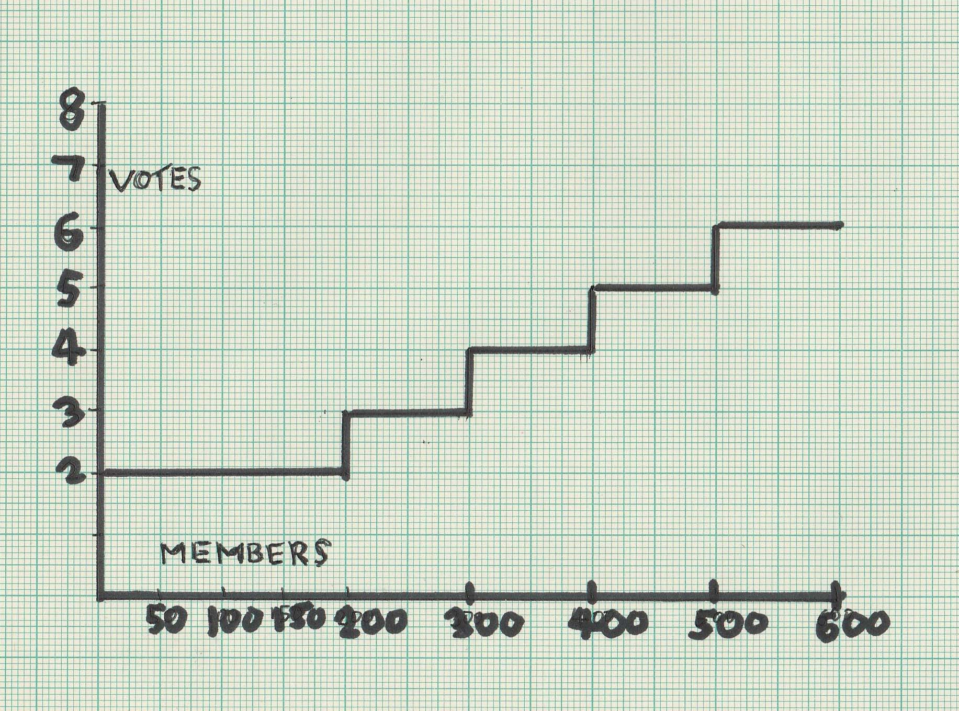
Plot with old rules

Slide 8
Plot including new rules

Slide 9
Our proposals
And secondly revision to levies calculations:(does not apply to insurance aspect of levy)

Slide 10
Relevant sections of current constitution on levies
50. Dues and levies upon member Clubs, and dates for payment, shall be fixed by a General Meeting of the Association. They shall be proportional to the membership of a Club, except that Clubs with over 1000 members shall pay half rates for any member after the first 1000.(reminder: 201-1000 1 vote per 100 or part thereof 1001+ 1 vote per 200 or part thereof ie half voting rights)

Slide 11
Proposed revision of article 50
Dues and levies upon member clubs, and dates for payment, shall be fixed by a General Meeting of the Association. They shall be proportional to the membership of a Club, except that Clubs with over 200 members shall pay half rates for any member after the first 200.

Slide 12
Why is this important?
Most clubs are trying to cut costs so as to reduce membership fees in light of competition.
London has reduced its costs which is reflected in lower membership subscriptions (£55 reduced to £25).
We have managed to reverse a decline in numbers but this requires heavy spend on marketing.

Slide 13
Impact of our proposals
We acknowledge that under our proposal all clubs will pay a larger basic levy – but currently larger clubs are paying more than their fair share.
This can be seen in the chart below.
Our proposals are still weighted towards the smaller clubs.
Larger clubs still contribute more than is reflected in their voting power but our proposal goes some way towards fairness

Slide 14
Impact of our proposals
 | CURRENT |  | PROPOSED
 | % revenue contribution | % financial voting power | % revenue contribution | % financial voting power
Clubs >300 (1) | 8.84 | 4.55 | 7.57 | 5.61
Clubs >200 (5) | 34.27 | 15.91 | 32.79 | 22.53
Clubs >100 (4) | 14.6 | 9.09 | 15.31 | 10.28
Clubs >50 (14) | 28.82 | 31.82 | 29.59 | 29.91
Clubs <50 (15) | 14.07 | 38.64 | 14.75 | 28.04
Notes:
Smallest clubs still only pay one third revenue but still have 23% of voting power.

Slide 15
Impact of our proposals?
Current memership is 3,575
Current levy =2.84(excluding insurance)
Current income = 10,153.08
Adjusted membership = 3,410(for calculation of levy NOT INCL INSURANCE)
Levy required to maintain income = £2.98
An increase of only 14p per head
Notes:
Spending on AIVC would still be comparable with present spending.

Slide 16
Our proposals are in the spirit of the original constitution. We are committed to a strong AIVC that serves its constituent clubs well and that enables us to learn from each other in a challenging environment.

Slide 17
